Slide 1
10_Feeders_No_Foreign_WTIVs
t
e
x
t

Slide 2
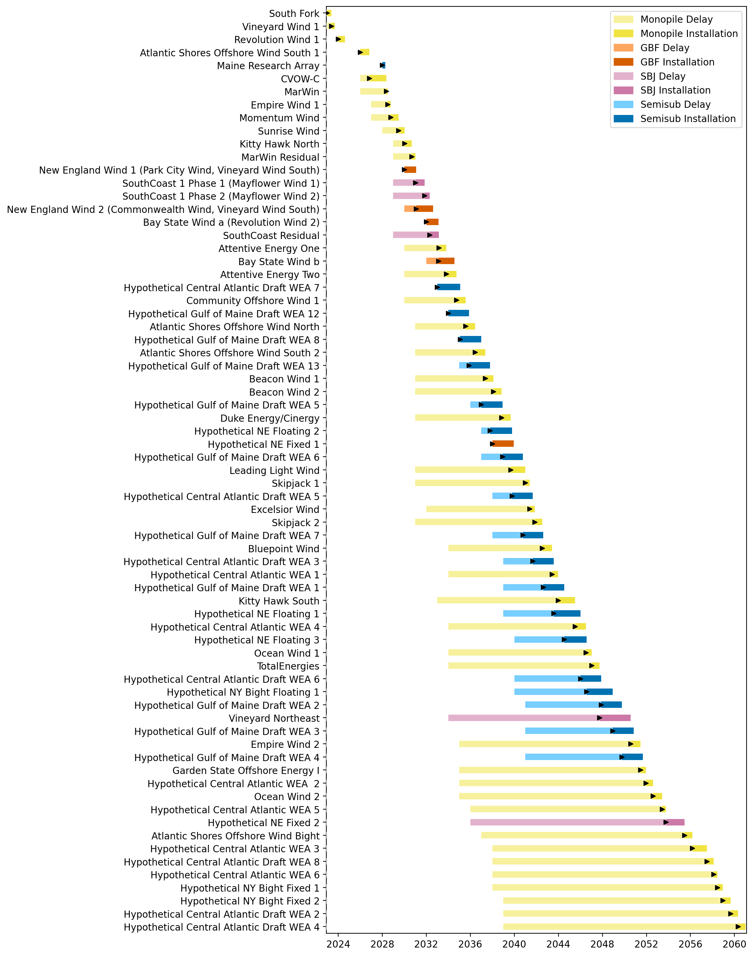
Full Gantt

Slide 3
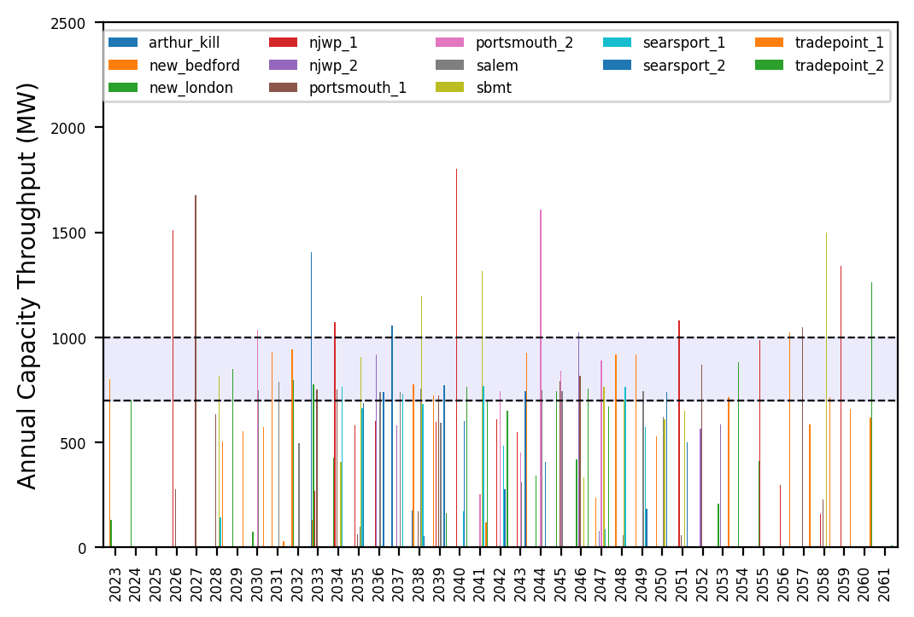
Port Throughput

Slide 4
Hybrid_Optimized_Pipeline_Low
t
e
x
t

Slide 5
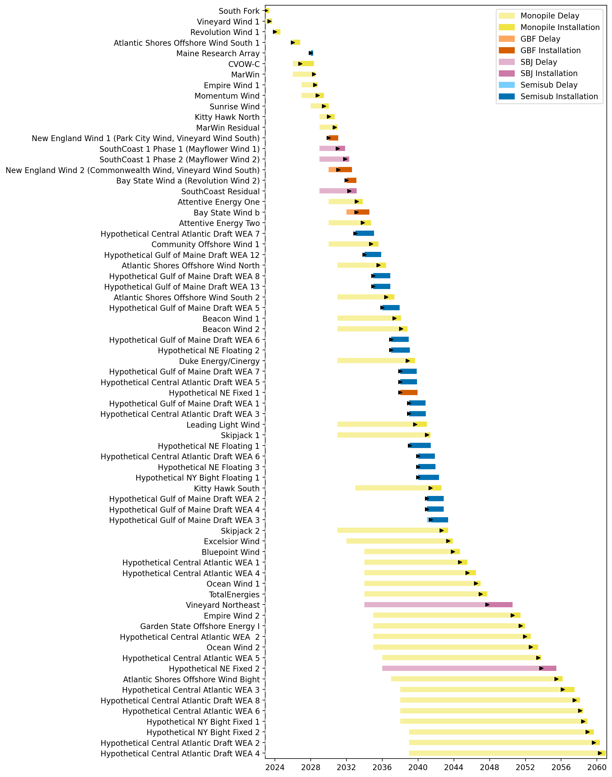
Full Gantt

Slide 6
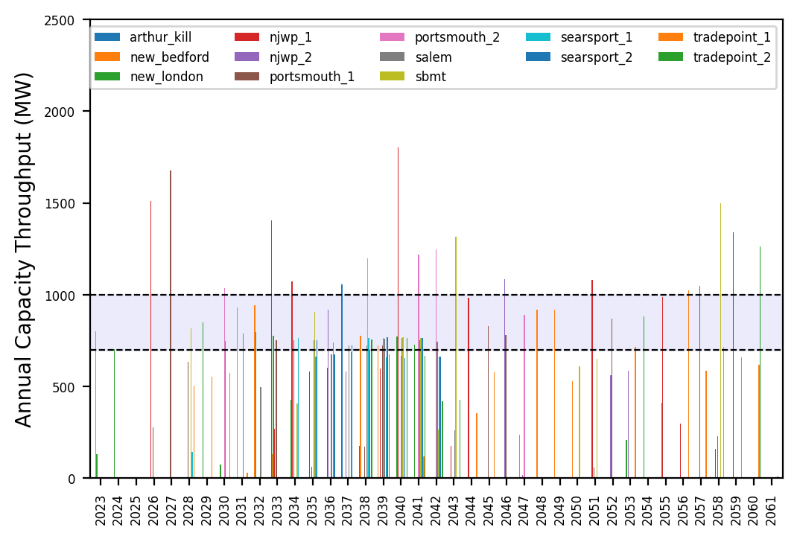
Port Throughput

Slide 7
10_Feeders
t
e
x
t

Slide 8
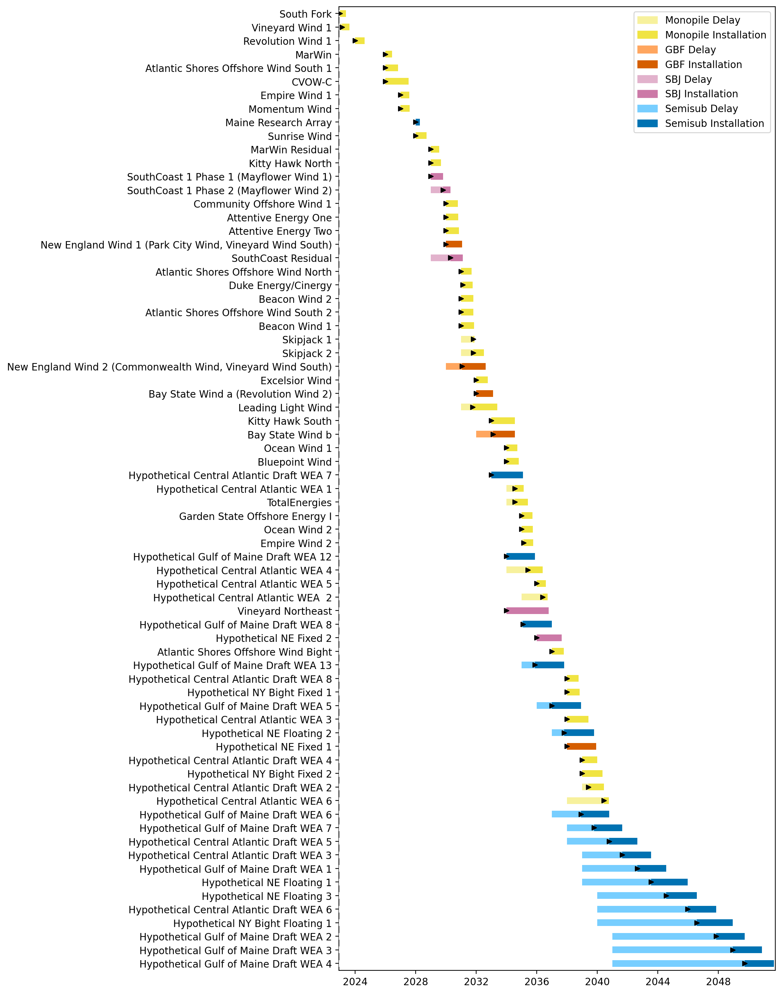
Full Gantt

Slide 9
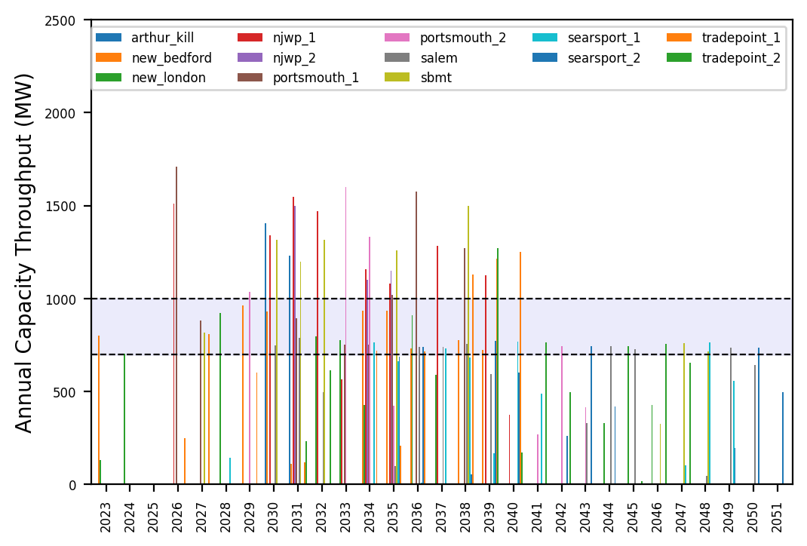
Port Throughput

Slide 10
6_AHTS_GBF_Pipeline
t
e
x
t

Slide 11
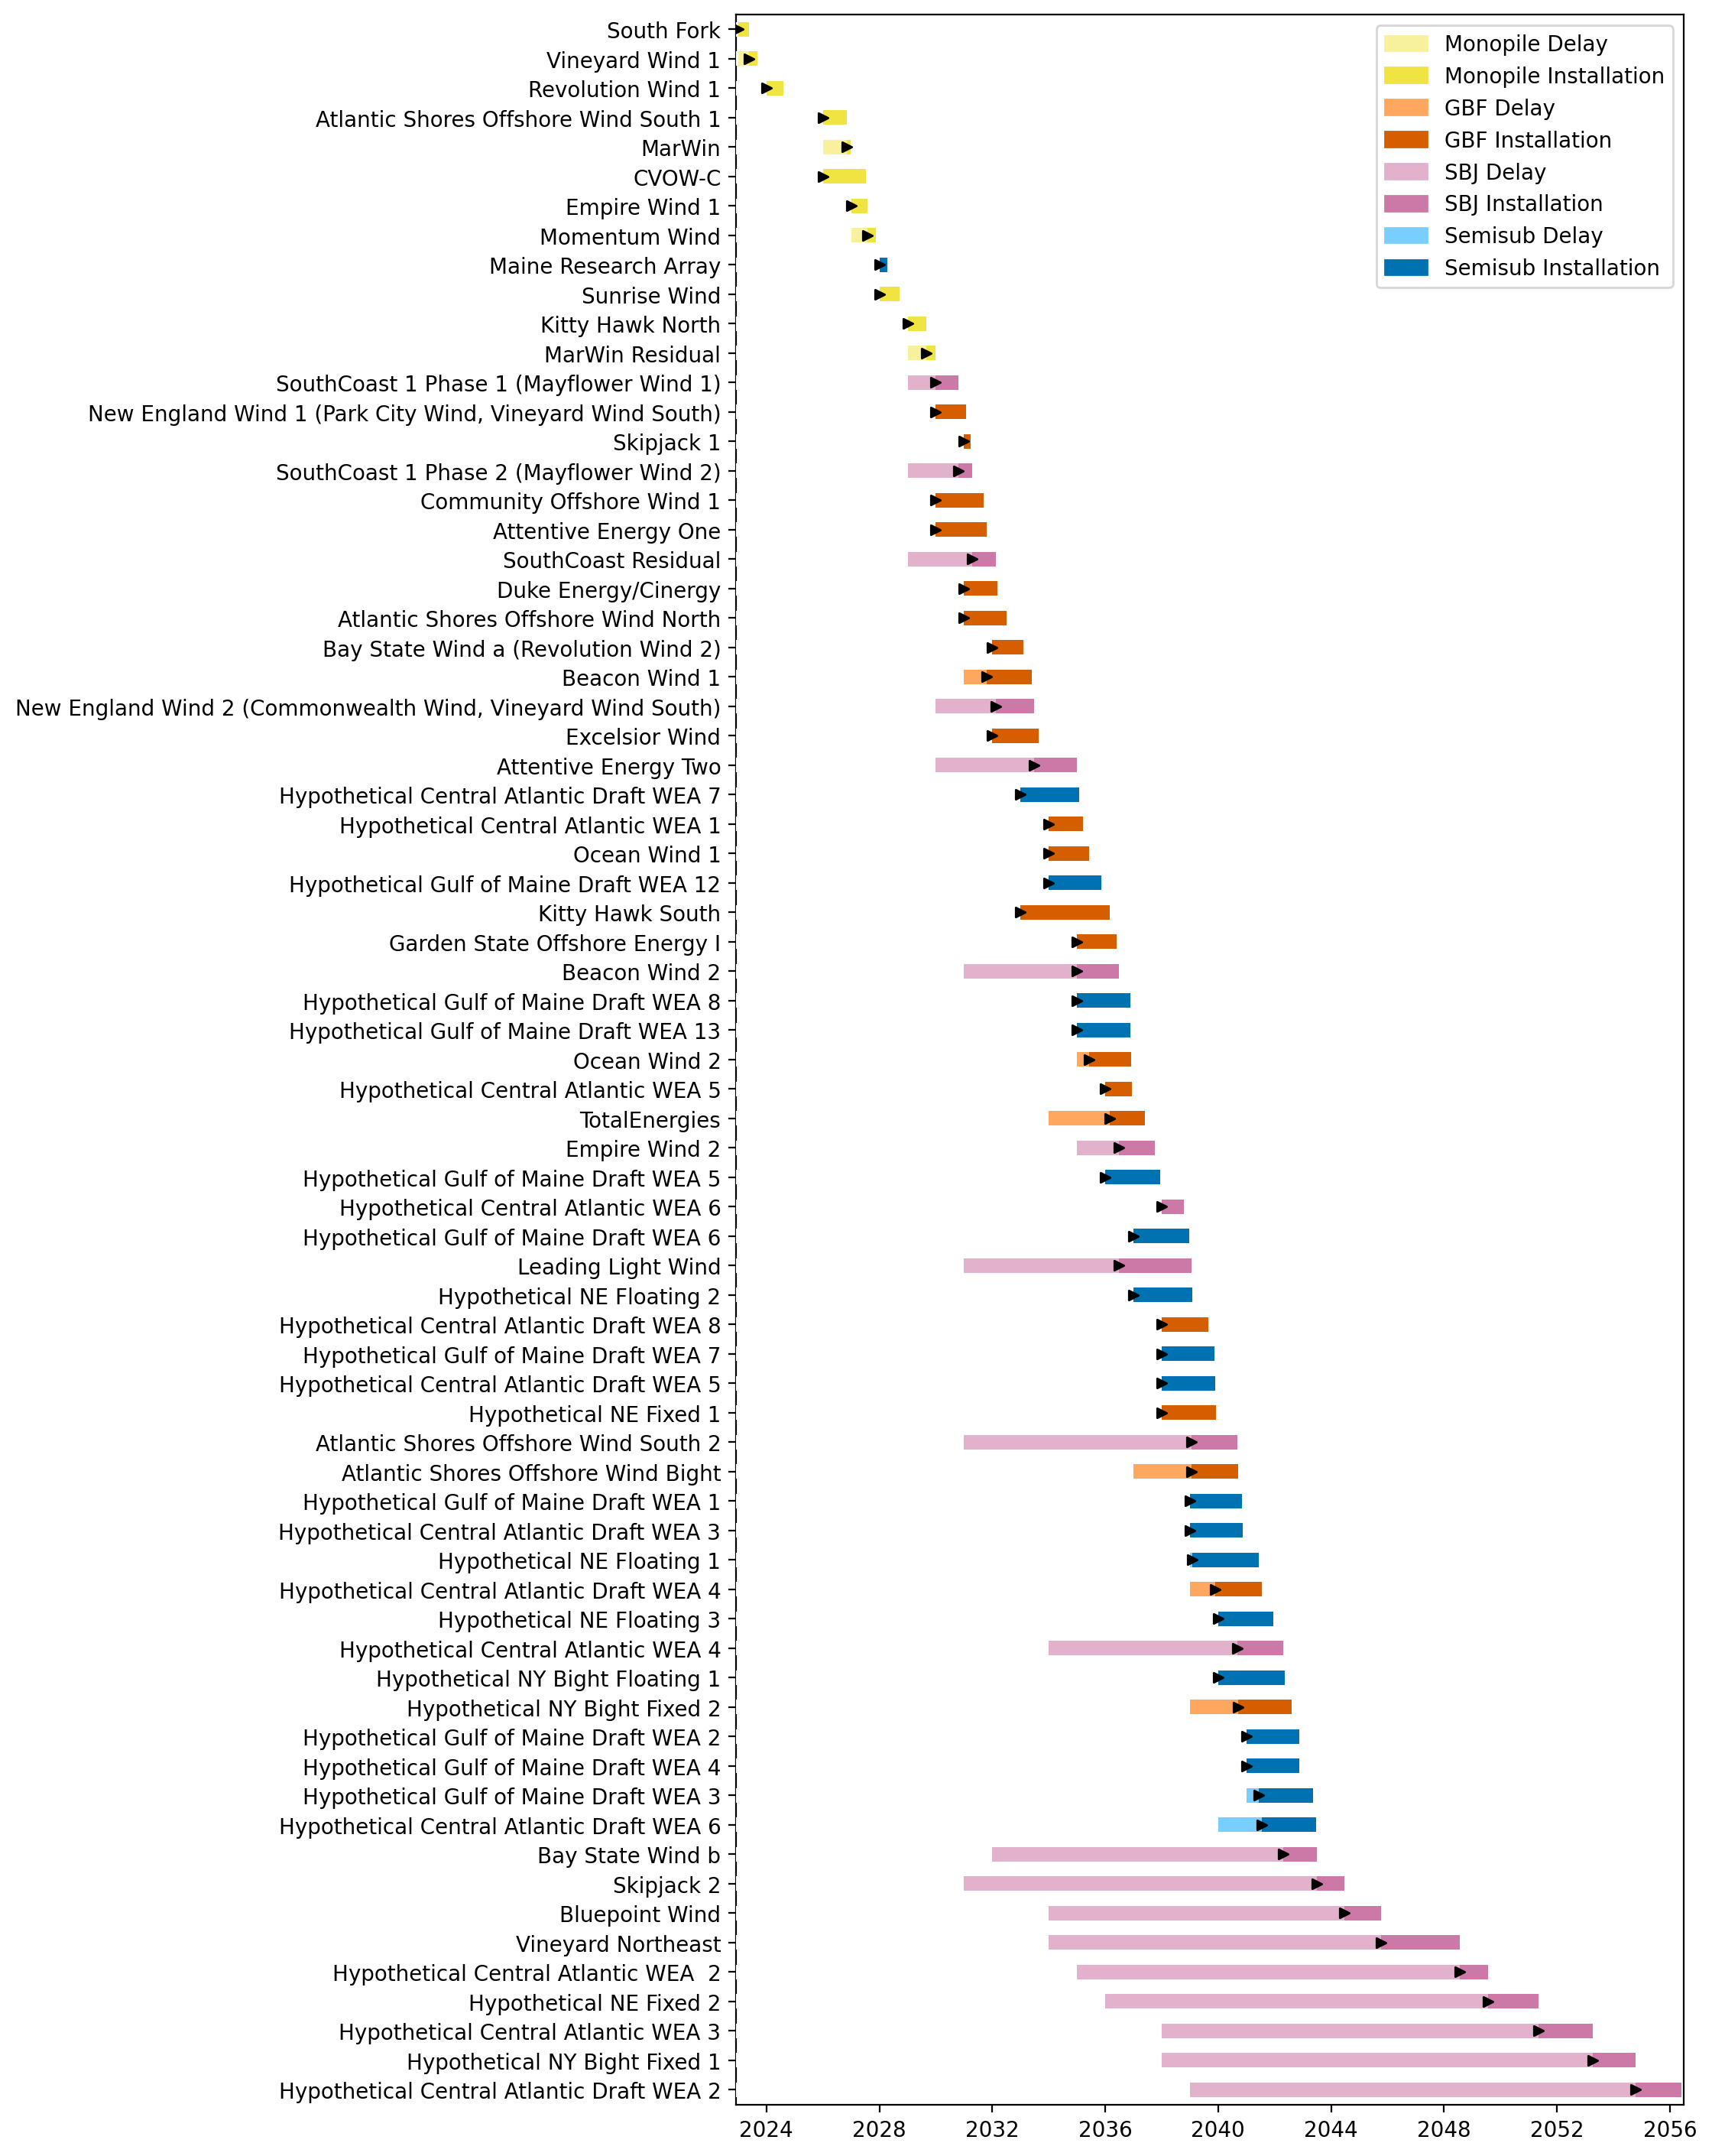
Full Gantt

Slide 12
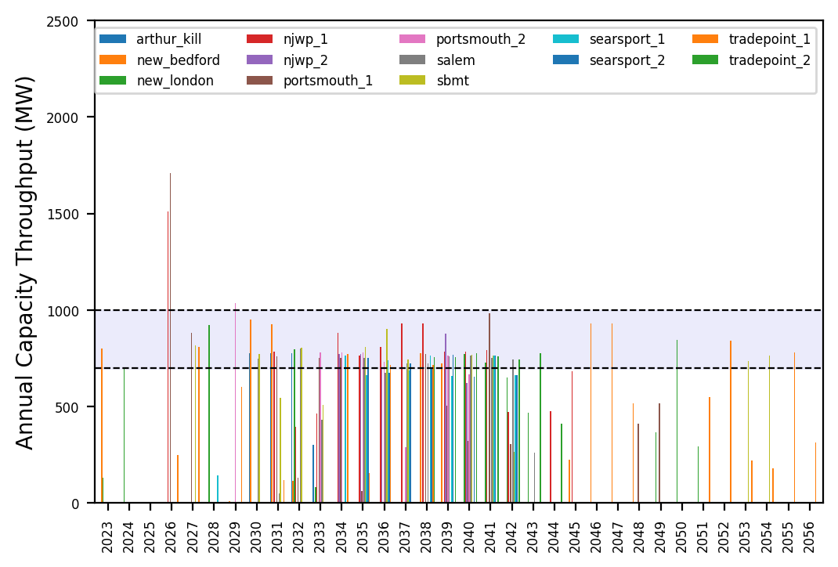
Port Throughput

Slide 13
3_WTIV
t
e
x
t

Slide 14
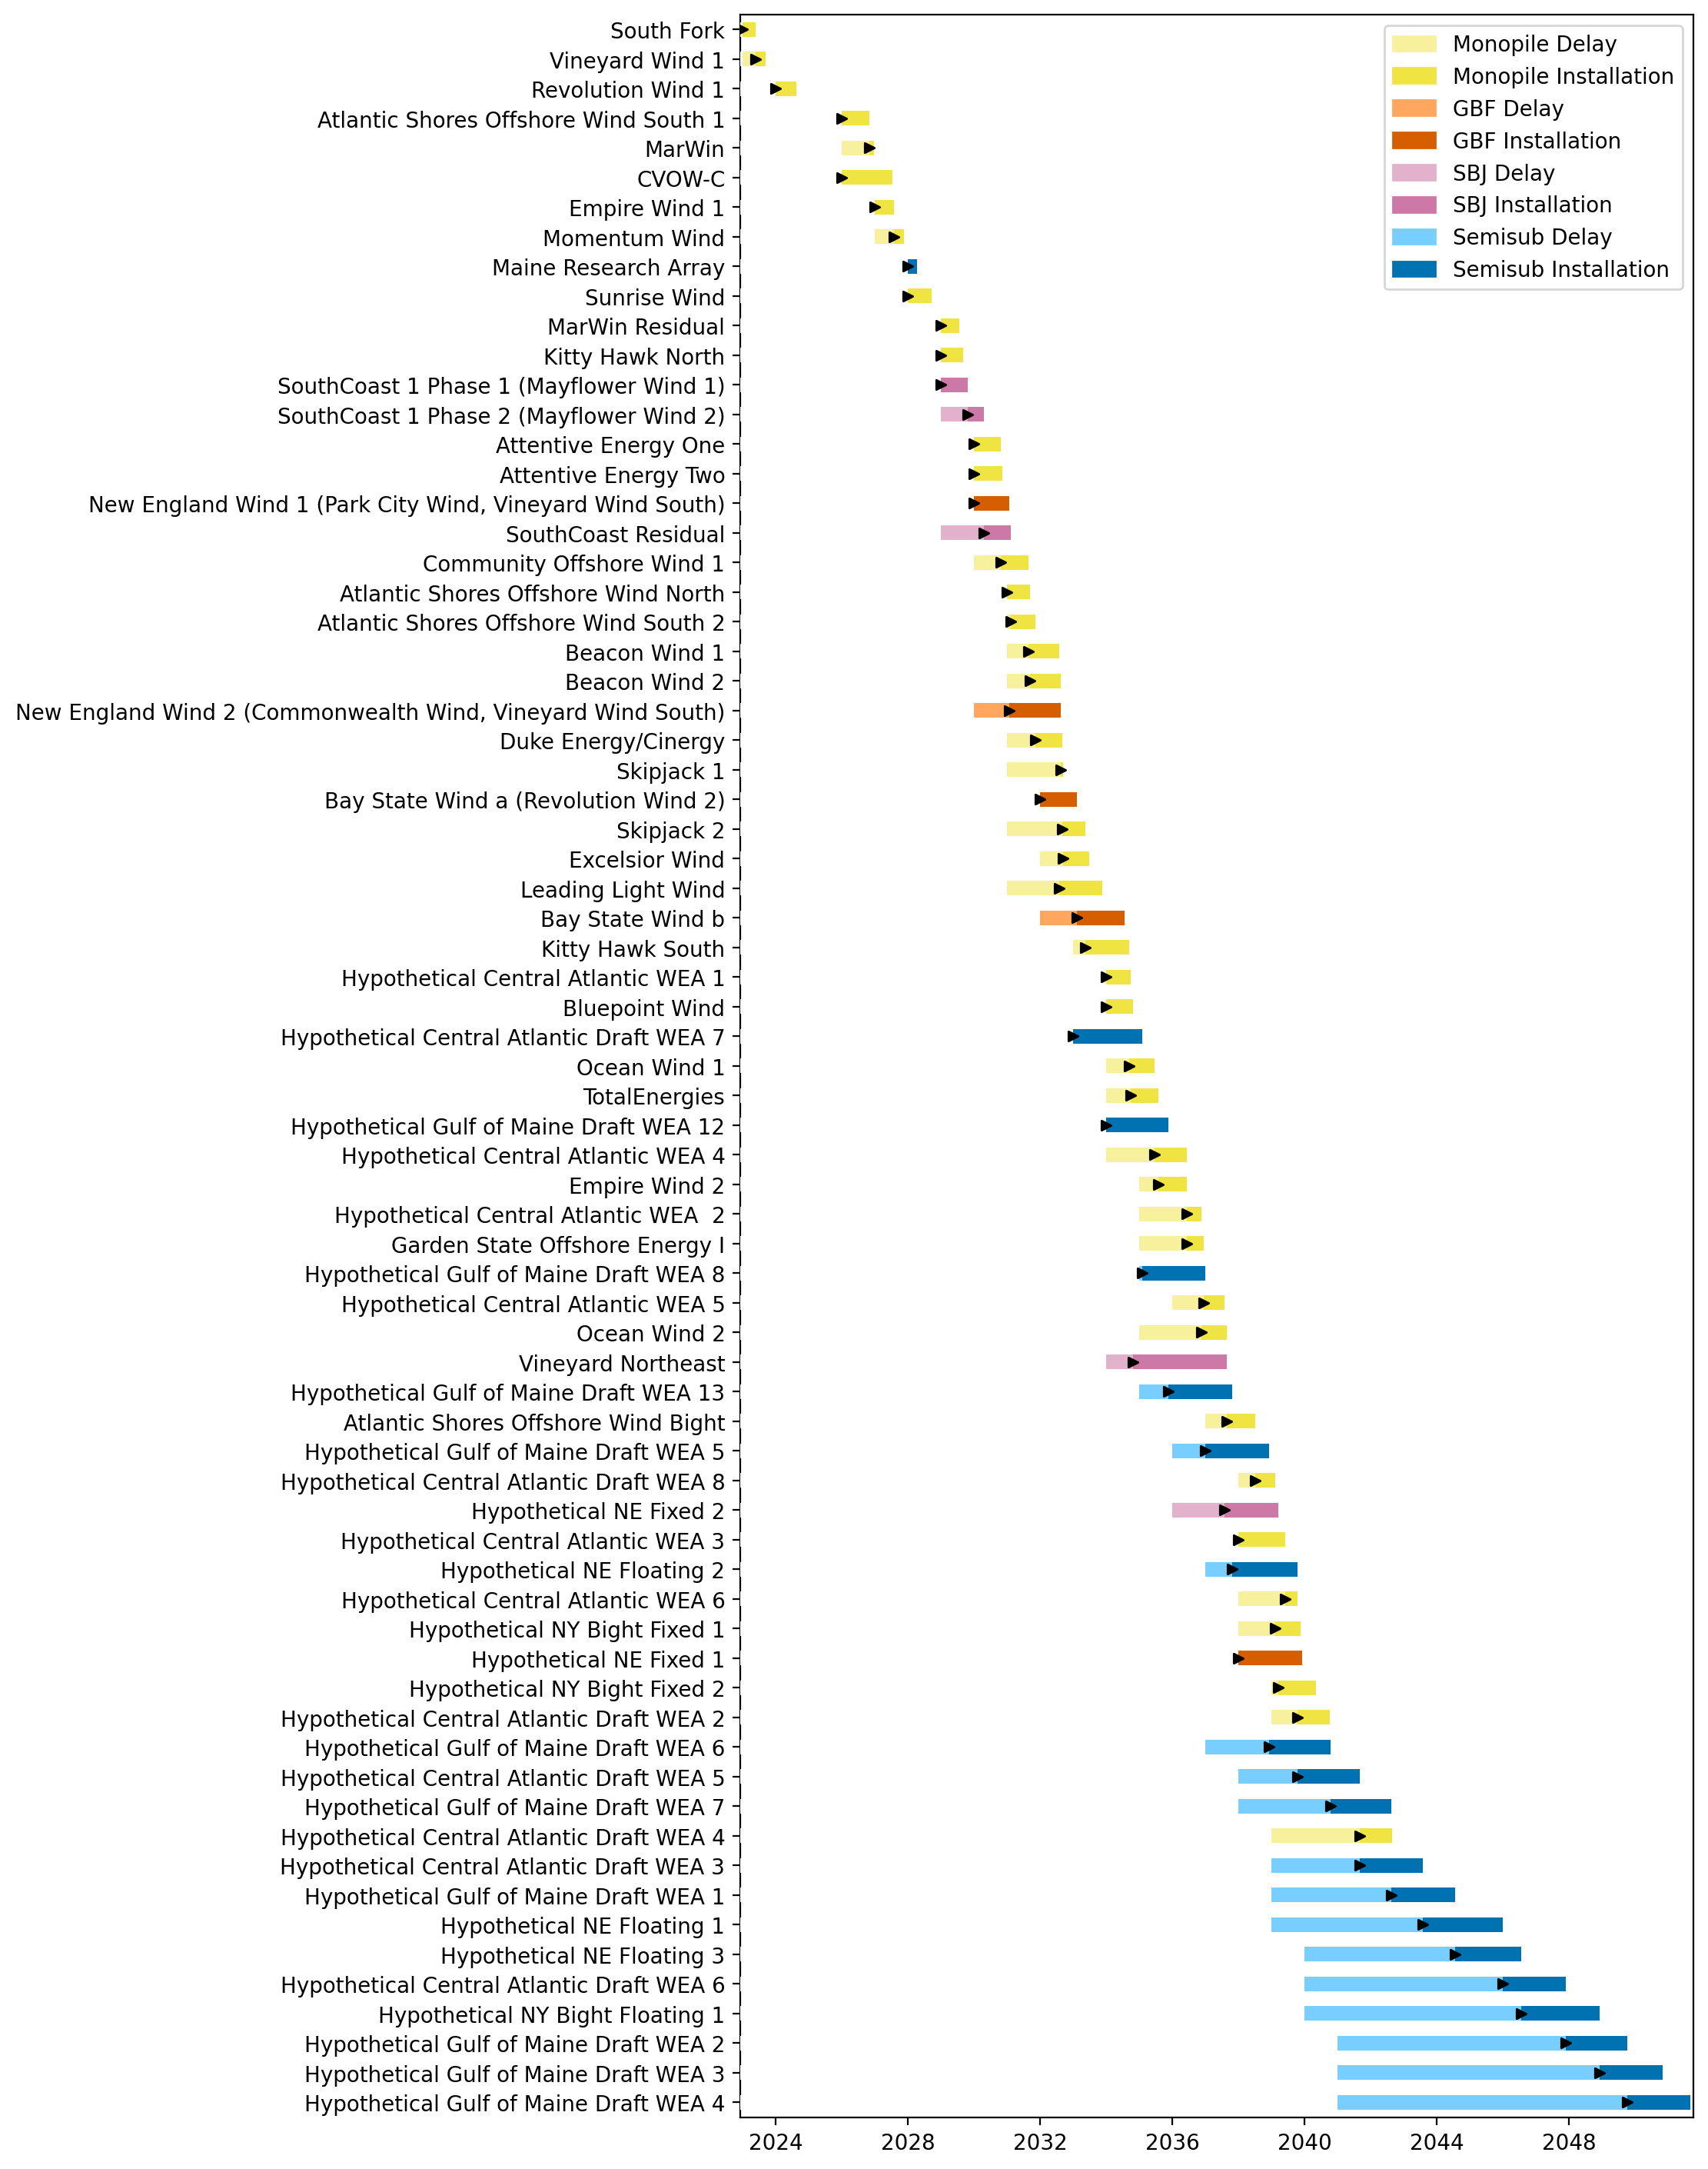
Full Gantt

Slide 15
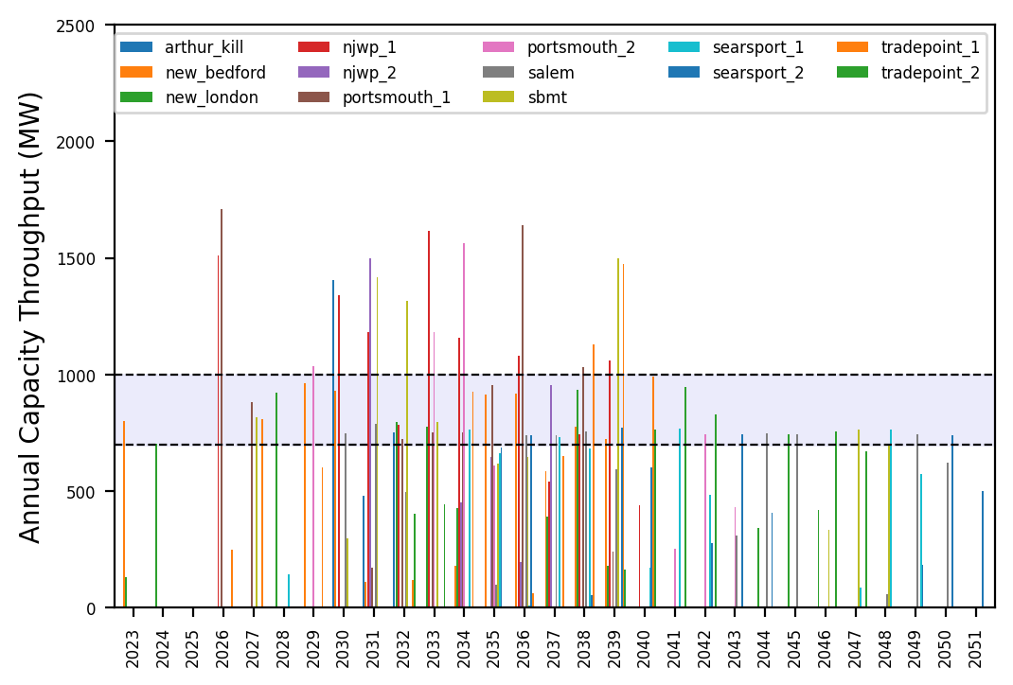
Port Throughput

Slide 16
6_AHTS
t
e
x
t

Slide 17
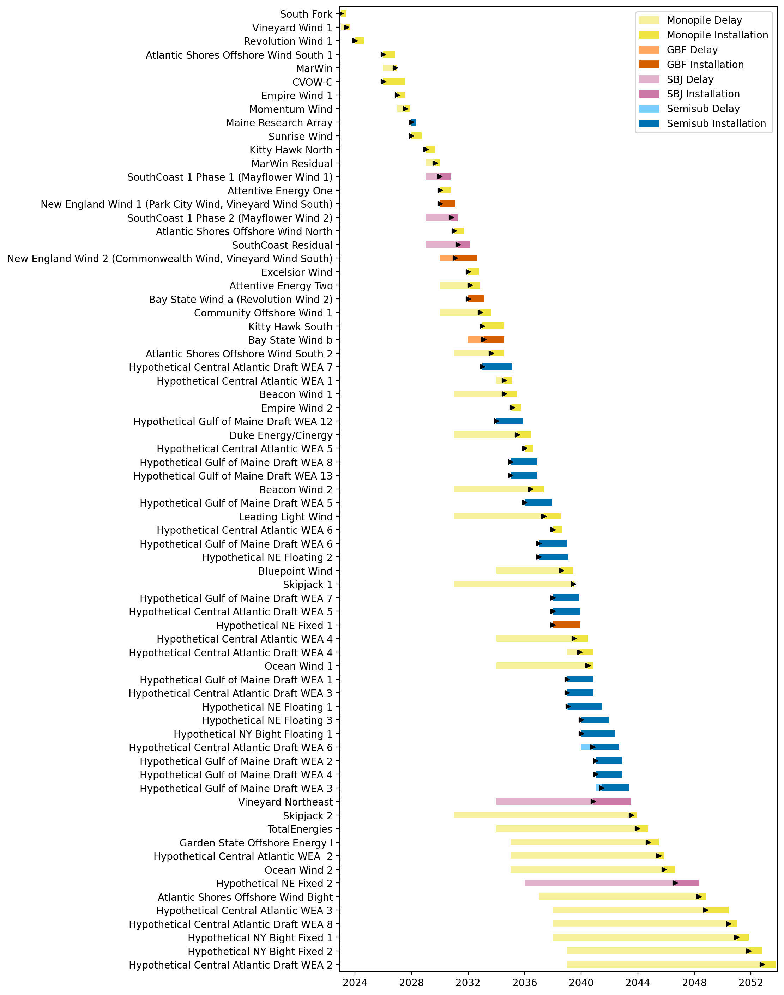
Full Gantt

Slide 18
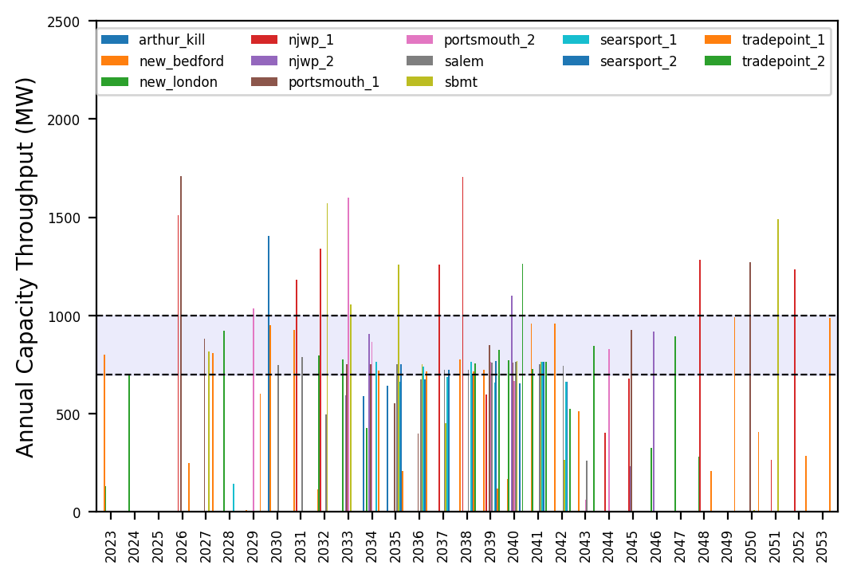
Port Throughput

Slide 19
no_action
t
e
x
t

Slide 20
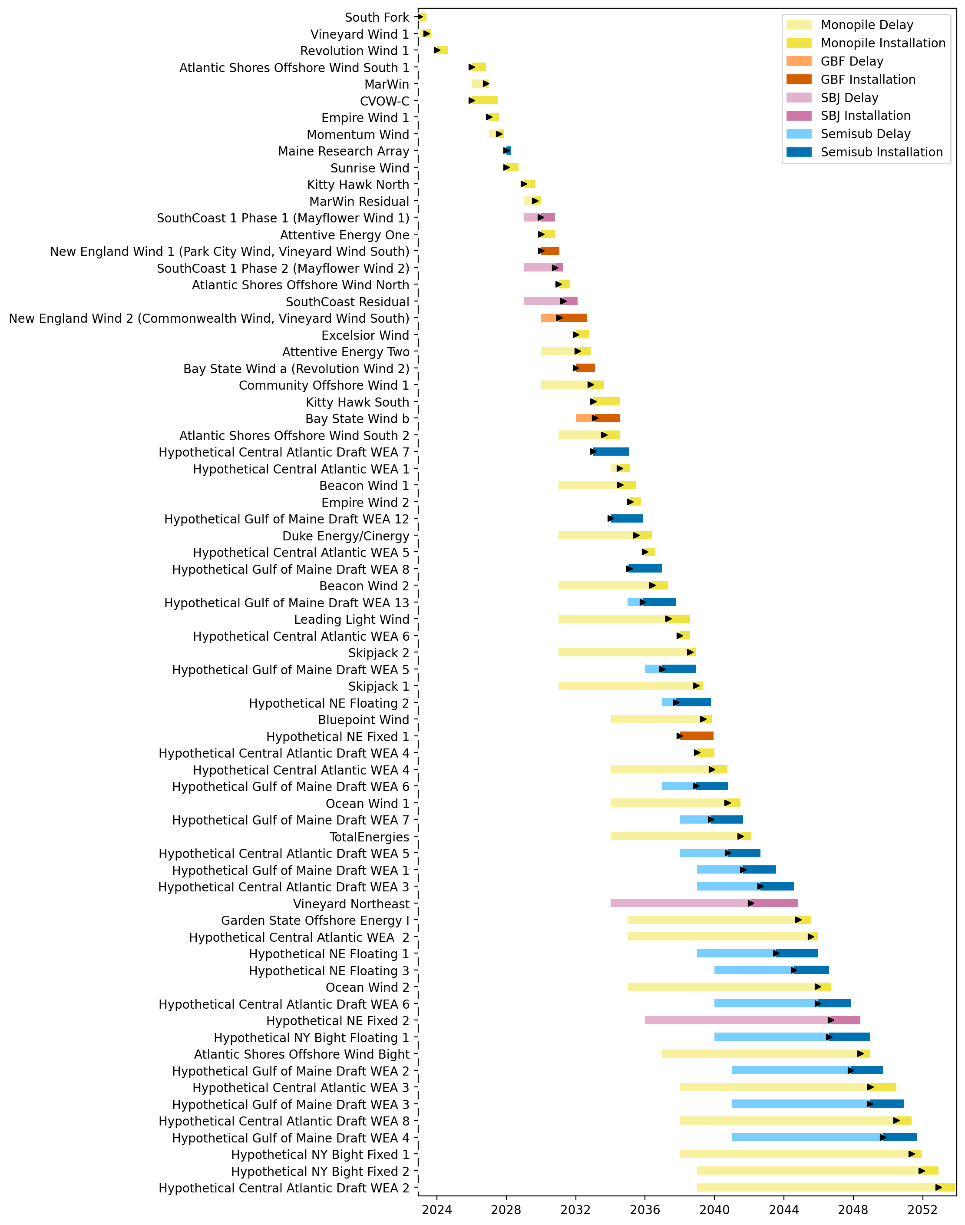
Full Gantt

Slide 21
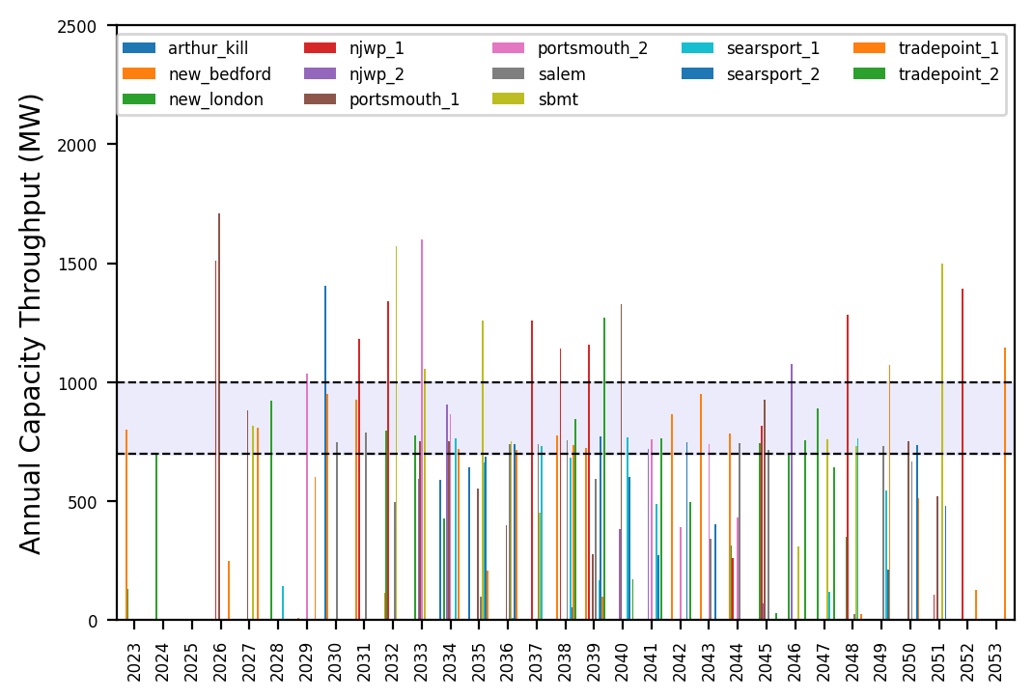
Port Throughput

Slide 22
3_WTIV_No_Foreign_WTIVs
t
e
x
t

Slide 23
Full Gantt

Slide 24
Port Throughput

Slide 25
Hybrid_Optimized_Pipeline
t
e
x
t

Slide 26
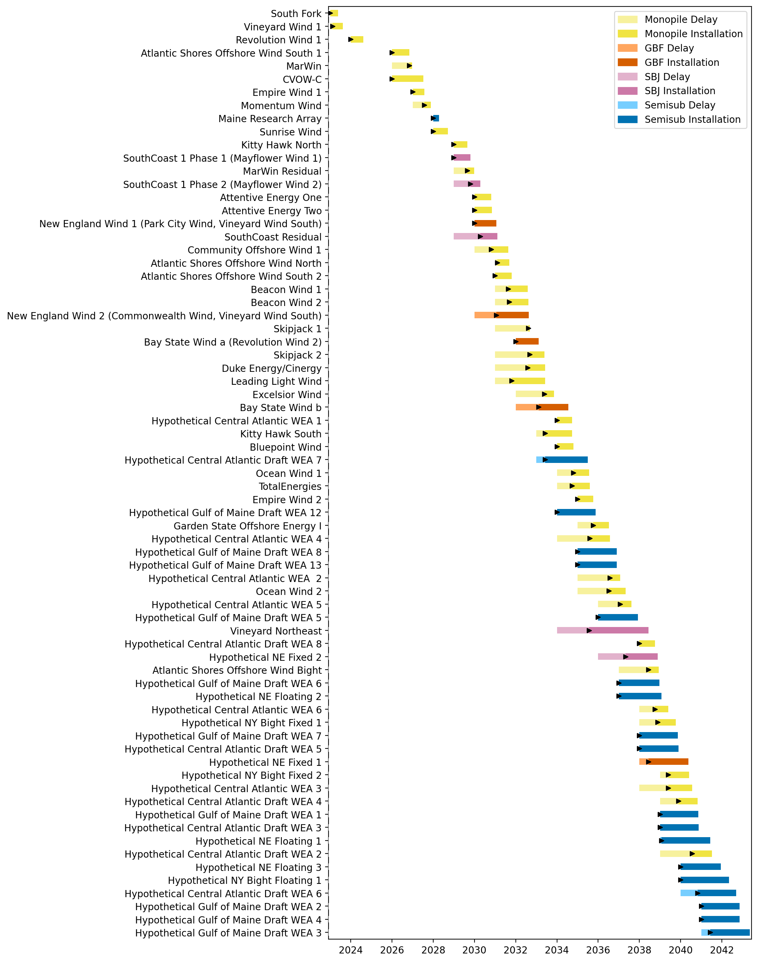
Full Gantt

Slide 27
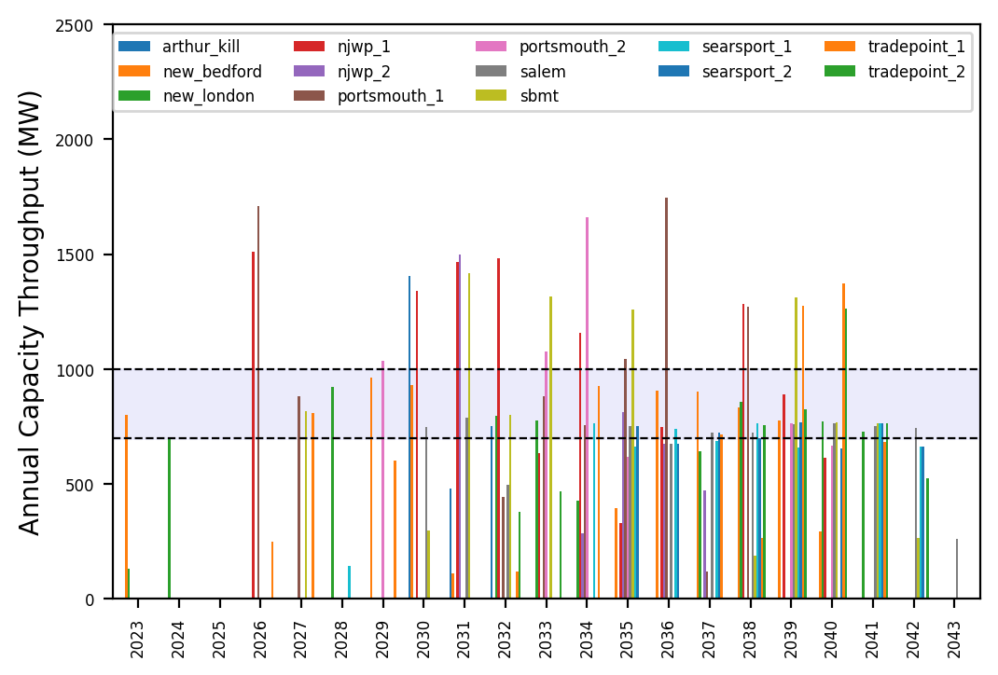
Port Throughput

Slide 28
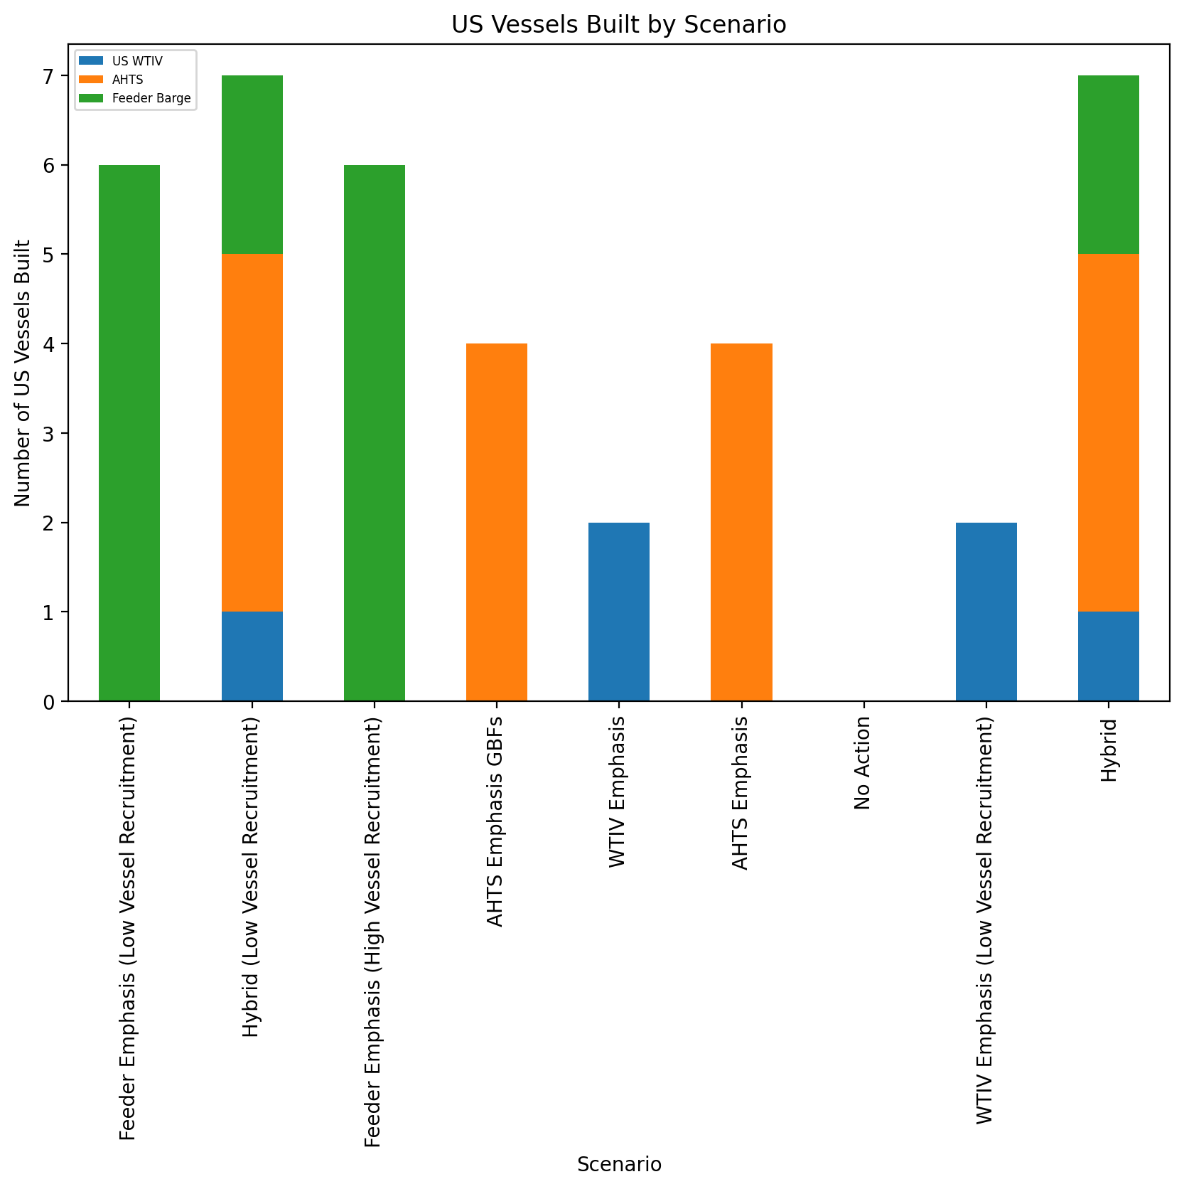
US Vessels Built

